Slide 1
G PULLA REDDY ENGINEERING COLLEGE(AUTONOMOUS) MAJOR PROJECT FLOWER DETECTION
TEAM MEMBERS: GUIDE:
P.PAVANI REDDY (179X1A05C7) Smt. T. SWATHI
G.NAVEEN KUMAR (189X5A05J3) Assistant Professor, CSE
L.VENKATA SAI KOUSHIK (179X1A0592)

Slide 2
ABSTRACT
Natural flower classification is a challenging task due to the non-rigid deformation, diversity of flower species and inter-class similarity. It is very hard to classify them as they can be very similar to each other. Deep CNN techniques have become the latest technology for such problems.
Our project aims to develop an flower classification model using Deep Convolutional Neural Network (CNN) with the support of Keras and Tensor Flow libraries for extracting the features. Sequential model from Keras is used to build the flower classifier. This method for classification of flowers can be implemented in real-time applications and can be used to help botanists for their research as well as camping enthusiasts. Moreover, the system is capable of automatically recognize the flower name with a good accuracy.

Slide 3
INTRODUCTION
Unlike simple object classification such as distinguishing cats from dogs, flower recognition and classification is a challenging task due to the wide range of flower classes that share similar features.
Deep learning techniques, especially convolutional neural networks (CNNs), can be chosen as the best option for the training process because it produced a high percentage of accuracy.
The input data used, mainly focuses on categorizing flowers of five types (Daisy, Sunflower, Rose, Tulip, Dandelion).

Slide 4
What is CNN
CNN is a type of deep learning model for processing data that has a grid pattern, such as images.
The CNN includes convolution layers, pooling layers, and fully connected layers. A typical architecture consists of repetitions of a stack of several convolution layers and a pooling layer, followed by one or more fully connected layers.
A convolution layer is a fundamental component that performs feature extraction.
A pooling layer provides down sampling operation which reduces the in-plane dimensionality of the feature maps

Slide 5


S/W and H/W REQUIREMENTS
S/W Requirements
1. Latest Version of Python
2. Libraries like TensorFlow, Keras
3. Jupyter Notebook
H/W Requirements
1. 64-bit Processor
2. 4GB or more than 4GB RAM is required

Slide 6
Papers Referred
[1] Mohd Azlan Abu1 , Nurul Hazirah Indral, Izanoordina Ahmad: “A study on Image Classification based on Deep Learning and Tensorflow”, International Journal of Engineering Research and Technology. ISSN 0974-3154, Volume 12, pp. 563-569
[2] Saad Albawi, Tareq Abed Mohammed: “Understanding of a Convolutional Neural Network”, The International Conference on Engineering and Technology 2017, At: Antalya, Turkey

Slide 7
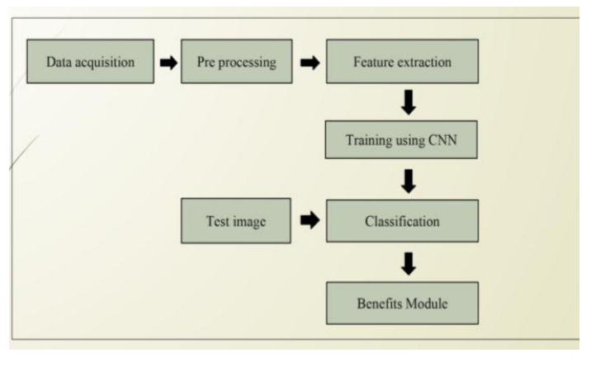
Key findings of “A study on Image Classification based on Deep Learning and Tensorflow”
Several flowers from different types share similar colour, shape and appearance. Furthermore, images of different flowers usually contain similar surrounding objects.
Deep learning techniques, especially Convolutional Neural Networks (CNNs),gives good accuracy, especially in image classification technology.

Slide 8
The roles of epochs in CNN is able to control accuracy and also prevent any problems such as over fitting.
Epoch : An epoch means training the neural network with all the training data for one cycle.
Implementation of deep learning by using framework TensorFlow gives good results as it is able to simulate well.
Python can be used as the programming language since it comes together with TensorFlow framework.

Slide 9
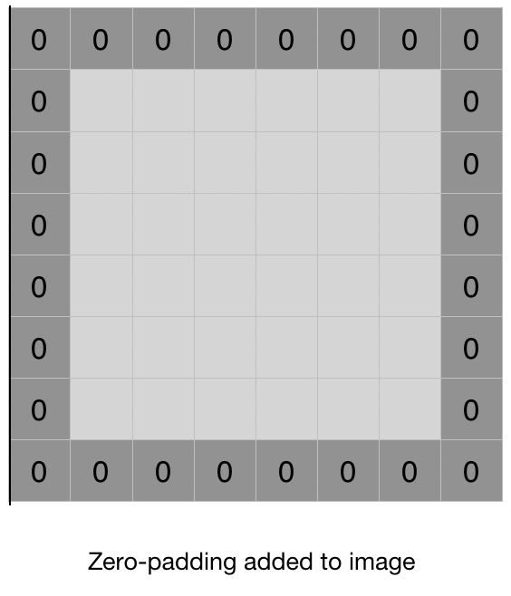
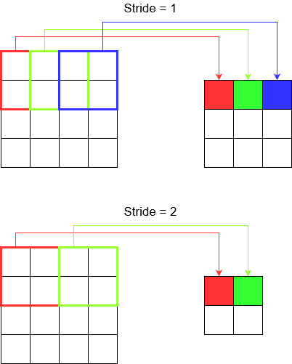
Key findings of “Understanding of a Convolutional Neural Network”
Important aspects related to Convolutional Neural Network (CNN) and the effect each parameter such as filters, padding, strides etc on performance of network .
Filters detect spatial patterns such as edges in an image by detecting the changes in intensity values of the image.
Padding is a term that refers to the amount of pixels added to an image when it is being processed by the filters
Stride is the number of pixels shifts over the input matrix.

Slide 10
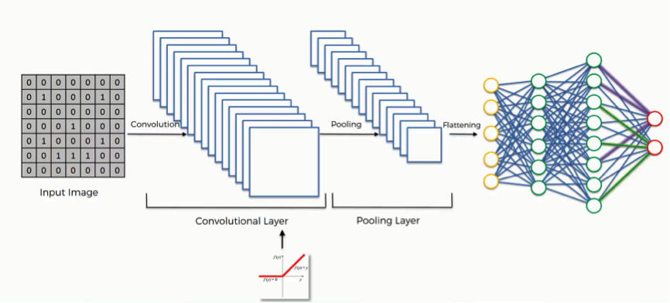
The most important layer in CNN is convolution layer which takes most of the time within the network.
Network performance also depends on the number of levels within the network. But in the other hand as the number of levels increases the time required to train and test the network.
Today the CNN consider as power full tool within machine learning for a lot of application such as face detection and image , video recognitions and voice recognition.

Slide 11
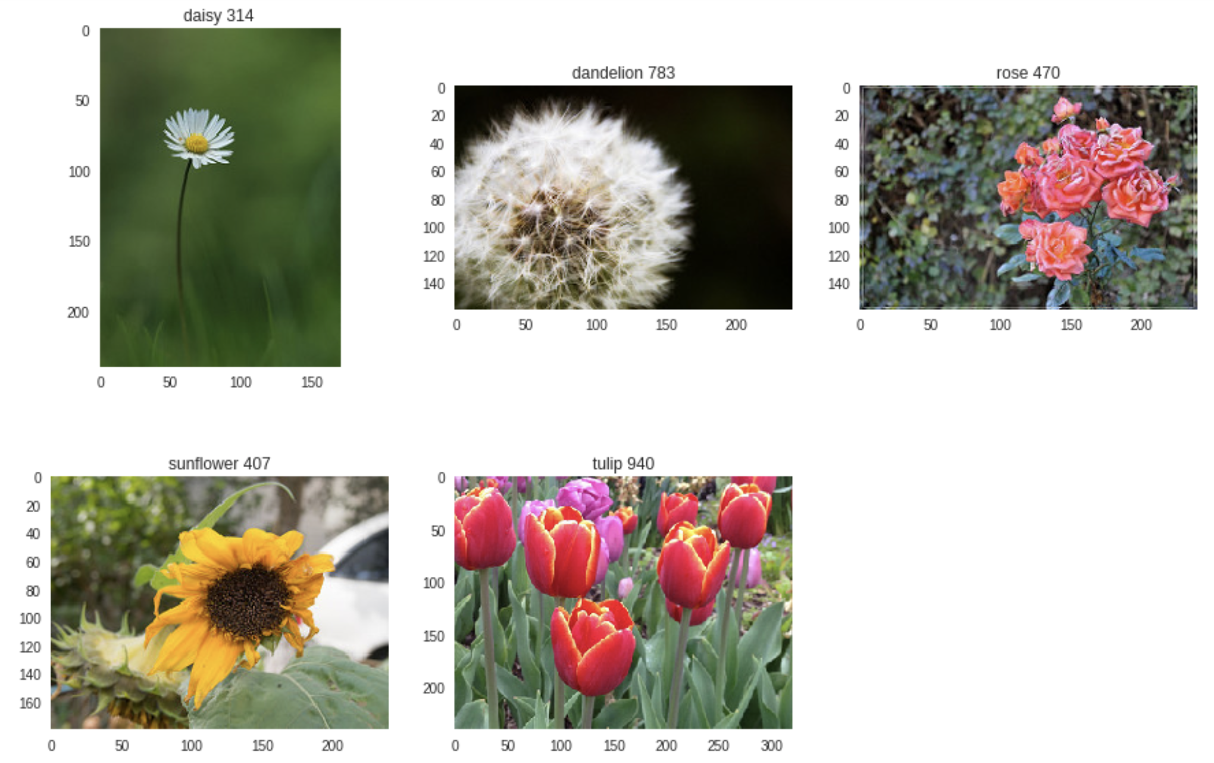
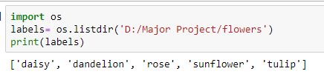
DATA SET
We have used the open-source Flowers Recognition dataset from Kaggle.
This dataset contains 4242 images of flowers.
The pictures are divided into five classes: daisy, tulip, rose, sunflower, dandelion.
For each class there are about 800 photos. Photo resolution is about 320x240 pixels.

Slide 12
Packages imported
cv2
numpy
tqdm
matplotlib.pyplot
LabelEncoder
to_categorical
train_test_split
Sequential
Conv2D, MaxPooling2D,
Flatten, Activation, Dense
ImageDataGenerator
model_from_json
image
confusion_matrix

Slide 13
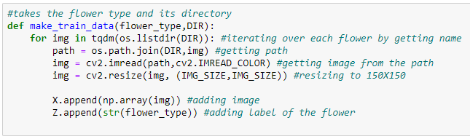
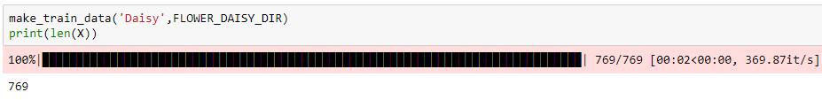
Data Preprocessing
Iterating over each image in a folder and resizing the image to 150X150
Storing image in the form of array in X.
Storing the corresponding type of flower in Z.
Repeating this for every flower type.

Slide 14


LabelEncoder from sklearn.preprocessing is used to encode target labels with value between 0 and n_classes-1. Here from 0 to 4.
Fit_transform(y) will fit label encoder and return encoded labels.
Normalise the values of X

Slide 15

Split the data
‘train_test_split’ of sklearn is used to split the data as Train data and Test data
The training set is used to train, or fit, your model.
The test set is needed for an unbiased evaluation of the final model.

Slide 16
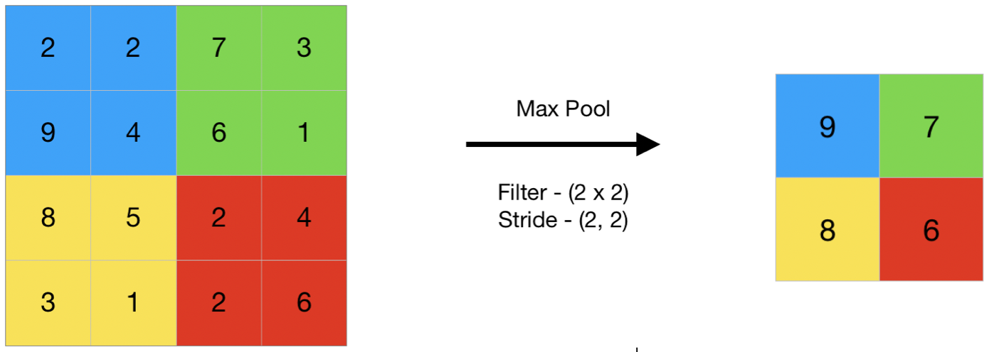
Layers
Sequential model: It allows you to build a model layer by layer. We use the ‘add()’ function to add layers to our model.
Conv2D layer: This is a convolution layer that will deal with our input images, which are seen as 2-dimensional matrices.
Max pooling layer: It is a pooling operation that selects the maximum element from the region of the feature map covered by the filter. The output would be a feature map containing the most prominent features of the previous feature map.
Flatten layer: Serves as a connection between the convolution and dense layers.
Dense layer: Dense is a standard output layer type that is most commonly used in many cases for neural networks.

Slide 17
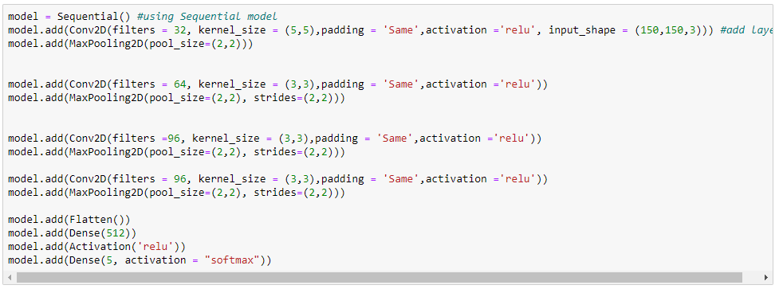
Adding layers to the model

Slide 18
Kernel size is the size of the filter matrix for our convolution. So a kernel size of 5,5 means we will have a 5x5 filter matrix.
Activation is the activation function for the layer. The activation function we have used is the ReLU, or Rectified Linear Activation.
Our first layer also takes in an input shape. This is the shape of each input image, 150,150,3 , with the 3 signifying that the images are of type RGB.
In the dense layer we will have 5 nodes which is our output layer, one for each possible outcome (0–4).
The activation is ‘softmax’. Softmax makes the output sum up to 1 so the output can be interpreted as probabilities. The model will then make its prediction based on which option has the highest probability.

Slide 19
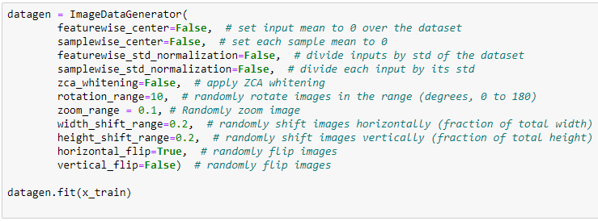
Image Augmentation
The image augmentation technique is a great way to expand the size of your dataset. You can come up with new transformed images from your original dataset.
Keras ImageDataGenerator allows to augment images in real-time while model is getting trained. Random transformations can be applied on each training image as it is passed to the model. This will not only make your model robust but will also save up on the overhead memory

Slide 20
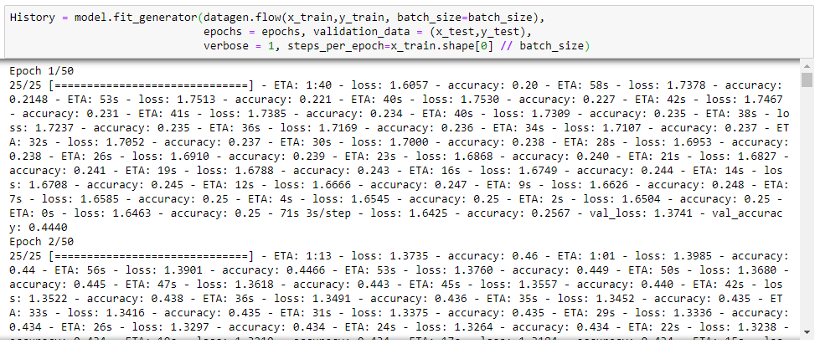
Compiling and Training

Slide 21

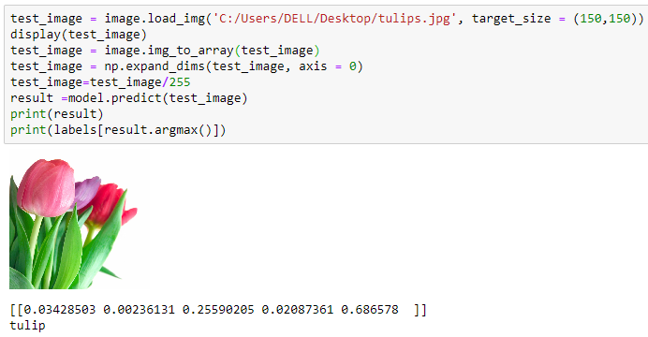
Predictions
Predictions on test data
Prediction on new image

Slide 22
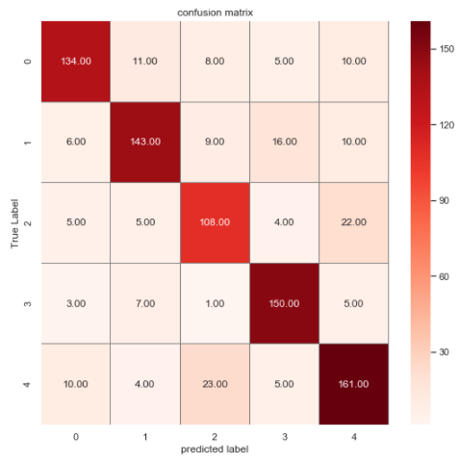

Performance measure
A confusion matrix is a table that is often used to describe the performance of a classification model (or "classifier") on a set of test data for which the true values are known.
Accuracy is the fraction of predictions our model got right.
The accuracy of the model is 80%

Slide 23
CONCLUSION
A model that predicts the type of the flower with 80% accuracy is built.
This method for classification of flowers can be implemented in real-time applications and can also be used to help botanists for their research for immediately identifying the properties of a flower.
Recognition of plant species will be advantageous in the fields such as the pharmaceutical industry, botany, agricultural, and trade activities.

Slide 24
THANK YOU

